Slide 1

The Battle of Neighborhoods: Quality of living
LANG (Michael) Xu

Slide 2


Introduction
Topic:
For this project, I have done some exploration on quality of living between two cities using the knowledge I have acquired from the IBM data science course from Cousera.
Background:
Those two cities I am using for the comparison are:
Dallas (Texas) Boston (Massachusetts)

Slide 3


Data Selection
There are two data set I used for this project:
The Foursquare data for specific location
The rental cost forecasting data from Zillow
Some additional resources:
Income tax calculator from Google

Slide 4
Methodology
The quality of living should consider from two parts:
1. The living rating
For living rating, the area radius is set as 2000 meters (1.24 miles, a comfortable biking distance)
Things I care the most: Gym, Grocery, Food place, and Shopping place
2. The salary requirement for maintain the living standard
Mainly focus on taxes and the cost of living, but I ignored the culture influence to the cost of living in both area
The exploratory analysis is completed on Jupyter Notebook with Python 3.7
1. For the code, please refer to the github link:

Slide 5
Comparison (living standard)
Dallas
Address: 4601 Amesbury Drive
Apartment: The teak
Monthly Cost: $1400
# of Food place: 49
# of Grocery place: 1
# of Shopping place: 3
# of Gym: 6
Boston
Address: 205 Revere Beach Pkwy
Apartment: One Beachmount
Monthly Cost: $2400
# of Food place: 33
# of Grocery place: 1
# of Shopping place: 0
# of Gym: 1

Slide 6
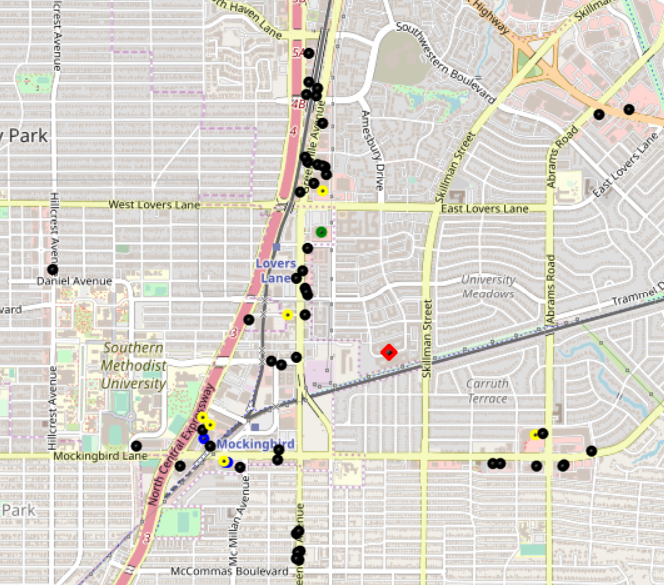
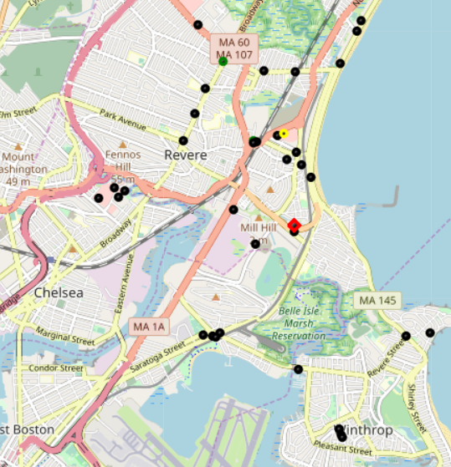
Comparison (living standard) continuous
Dallas
Boston (Revere)
Red: Apt
Black: Food
Yellow: Gym
Blue: Shopping
Green: Grocery

Slide 7
Comparison (living standard) overall
From a quality of living perspective, the "expected" area is similar to the are I used to live at. Both areas have a decent number of eating places with access to Gym nearly (ride a bike is an option to the Gym).
Good part of living in Boston:
1. Beach view
2. Public transportation (Train & Shuttle)
Downside of living in Boston:
1. Expected high living cost
2. Less enjoyable owes a car (road condition, bad weather, gas price)
3. Less Basketball game (less Gym)
Overall, I believed the quality of living are the same in both area

Slide 8

Comparison (Cost of living)
From Zillow’s data, the cost of living forecasting for renting is :
Suppose the annual salary in Dallas is $55,000
After tax =>$44,954
After Rent => $26,738 ( -$18,216)
Monthly spend=$1,800
After monthly spending=>$5,138 (-12*$1,800)
To maintain the same standard=>$5,138
Monthly spending=$1,800
Before Monthly spending=>$26,738 (+12*$1,800)
Before Rent => $54,914 (+$28,176)
Before Tax (in Boston)=> nearly $75,000

Slide 9
Conclusion
The entire analysis is a basic analysis of considering Salary Match. Please be aware I have not consider the culture influence in both area, which may stronly affect the monthly cost. As we can see, we probably need to get pay 36.4% (20000/55000) in order to keep the quality of living nearly the same in Boston.
All caculation is more like a consideration from an entire fmaily's perspective. If you were an adult who just graduated from college, you may want to think about the opportunty vesus the living quality

Slide 10
Thank You

